Slide 1
Smart Predictive Modeling for Rental Property Prices
Domain: Real Estate & Property Management

Slide 2
Problem Statement:
In the real estate industry, determining the appropriate rental price for a property is crucial for
property owners, tenants, and property management companies. Accurate rent predictions can
help landlords set competitive prices, tenants make informed rental decisions, and property
management companies optimize their portfolio management.
The goal of this project is to develop a data-driven model that predicts the rental price of
residential properties based on relevant features. By analysing historical rental data and
property attributes, the model aims to provide accurate and reliable rent predictions.

Slide 3
Key Tasks:
Data Preprocessing.
Feature Selection and Engineering.
Model Selection.
Model Training and Evaluation.
Hyperparameter Tuning
Interpretability.
Deployment
Expected Outcomes:
The successful implementation of the house rent prediction model will provide property owners, tenants, and property management companies with a tool to estimate rental prices accurately.
This will enhance transparency, aid in decision-making, and contribute to a more efficient and equitable rental market.

Slide 4
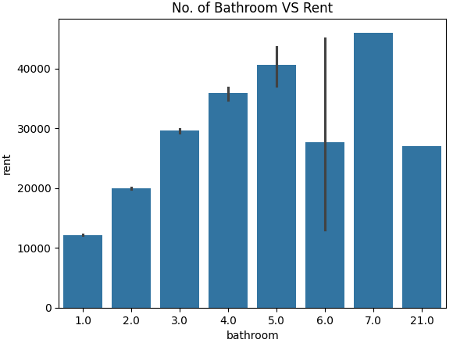
Exploratory Data Analysis:
Analysing House rent data is essential in house rent prediction project and several factors which really influence the prices of House rent. Here are some analysis we can explore using the dataset columns.!!
Correlation Analysis: How does the number of bathrooms affect the rent price?
Yes, by analysis with rental price vs No. of bathrooms, its seems higher the number of bathroom will cause high in rental price. PFB- chart.
Upon checking the right side chart, it clearly shows, 7 &
5 no. of bath rooms had high in price while comparing to
Others.
Letsss see others factors tooooo!!!!!

Slide 5
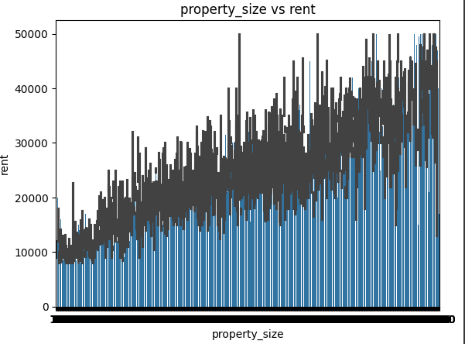
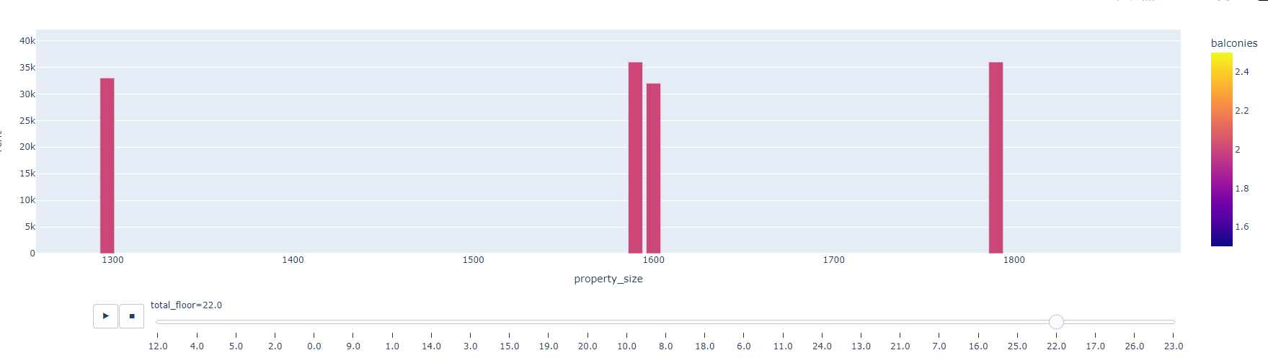
Lets see the relation between Property size and number of balconies effect!!
Upon Analysing, it seems that if the property size increases, the rental price also increases, along if the balconies increases, the rental prices will be in increase trend.

Slide 6
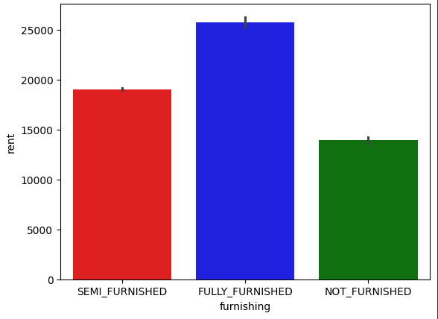
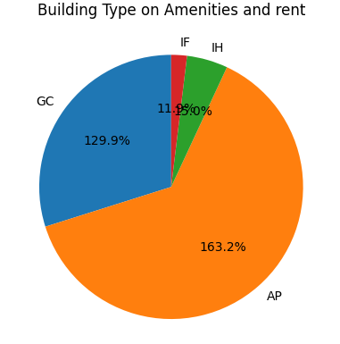
Building Amenities and Furnished types of Houses.
Lets see the Amenities like lift, swimming pool, gym on price factors on Flat types and avg- prices.
It seems that AP, GC flat types were had more.
Furnished VS rent

Slide 7
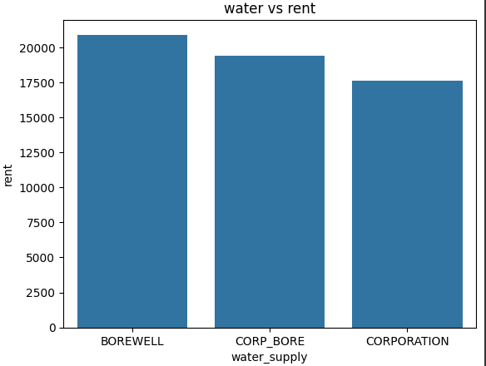
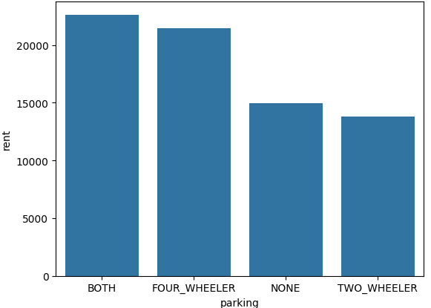
Parking VS Rent:
Water supply vs Rent
Borewell contributed high rent.
Corp water in 2nd place.
On Parking Houses which include both the 2 and 4 wheeler had high rate and in 2nd place if the houses had 4 wheeler, also selling in decent price.

Slide 8
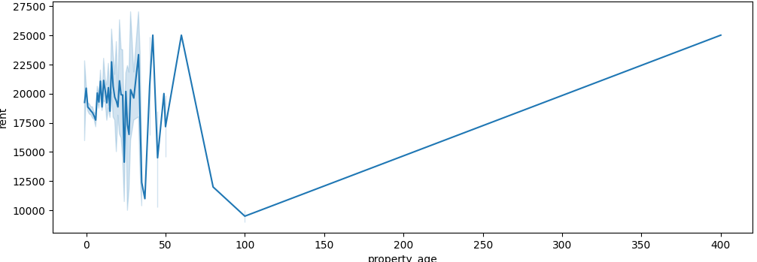
Lets see the property age vs rent price.
Yes, all of us know, if the age of property gets increased, the rental prices also getting high. We can see that the age after 100 it shows gradual increase in rental price.

Slide 9

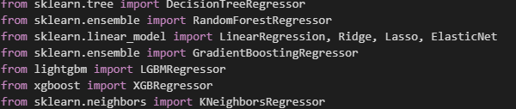
Feature Engineering & Model Selection.
After encoded the data which were in categorical to continuous columns, used train-test split and implement in Model.
After split the data, used several ML algorithms and implement the model.

Slide 10
Hyper-parameter & Evaluation:
Used GridSearchCV as Hyperparameter for LGBM.(Light Gradient Boosting).
Light GBM is a gradient boosting framework that uses tree based learning algorithm.
Light GBM grows tree vertically while other algorithm grows trees horizontally meaning that Light GBM grows tree leaf-wise while other algorithm grows level-wise. It will choose the leaf with max delta loss to grow. When growing the same leaf, Leaf-wise algorithm can reduce more loss than a level-wise algorithm.

Slide 11

Evaluation:
Upon checking with several algorithms, its LGBM give high r2_score, hence used it for model building.
R2_score(Coefficient of determination); How much the predicted value approximates the actual data.

Slide 12
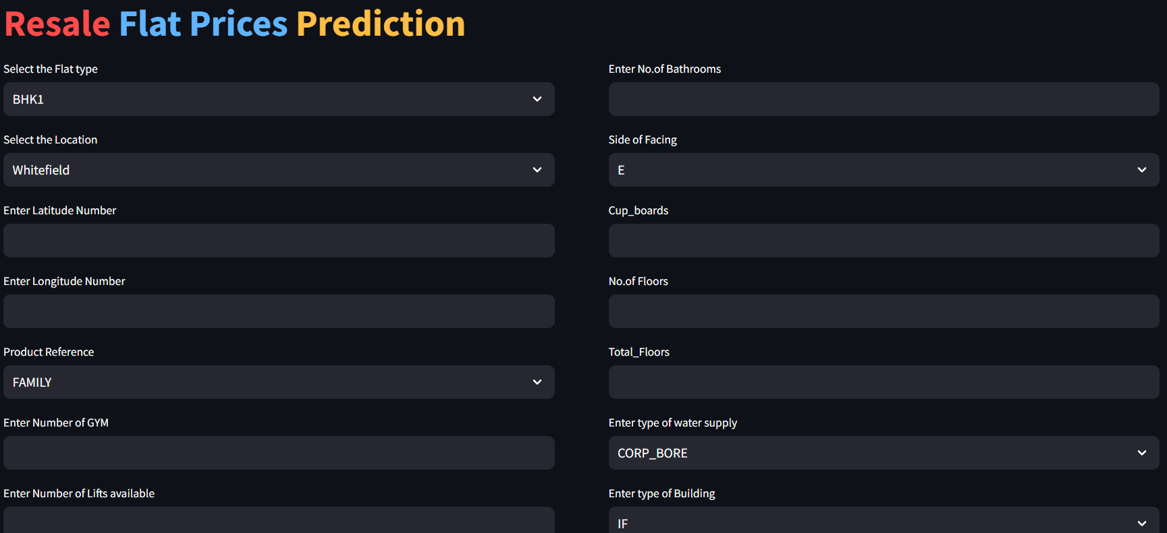
Deployment!!
Used Render Platform to deployed the model.
Render is one of the User-Friendly platform, where we can deploy our Machine learning model in simple steps.

Slide 13
Conclusion!!
In this machine learning project, our goal was to develop a model for predicting rental prices based on various property features. We started by exploring and analyzing the dataset, identifying key patterns and trends. The dataset underwent preprocessing steps, including handling missing values and outliers, as well as feature engineering to enhance model performance.
For the model development phase, we opted for a LightGBM (Gradient Boosting) model due to its efficiency in handling categorical features and overall strong predictive capabilities. The model was trained on a diverse set of features, including property type, location, amenities, and spatial coordinates.
Evaluation metrics such as Mean Absolute Error (MAE) and Mean Squared Error (MSE) were used to assess the model's performance. The LightGBM model demonstrated commendable accuracy in predicting rental prices, with MAE and MSE scores well within acceptable ranges.
Our findings highlight the significance of certain features, such as location and property type, in influencing rental prices. The model successfully captured complex relationships within the data, providing valuable insights for both tenants and property owners.
Despite the success, it's important to note that challenges were encountered, particularly in dealing with missing data and selecting relevant features. Future work could involve collecting additional data to further enhance model robustness.
In conclusion, our machine learning rental price detection model proves to be a valuable tool for estimating property rental prices. The project contributes to the broader field of real estate analytics, offering practical applications for both tenants seeking fair rental prices and property owners optimizing their rental strategies.

